Slide 1
SALES ANALYSIS PROJECT
HNI CORPORATION
PROJECT BY DIVYANI SHRIVASTAVA

Slide 2
CONTENT
INTRODUCTION ABOUT ANALYSIS
OBJECTIVE OF ANALYSIS
REPORTS(yearly)
DATA INSIGHTS
CONCLUSION

Slide 3
INTRODUCTION : Data used is of HNI corporation for this sales analysis project. The data includes details about companies sales in United States. Date is of two years 2019,2020 with information of sales done city wise, region wise including order date, ID, product details,ship date,payment mode, quantity of purchase. OBJECTIVE: Data is analysed yearly starting with the total sales done in an year with yearly profit and other visualization of payment choices product in demand segment wise,category wise.

Slide 4
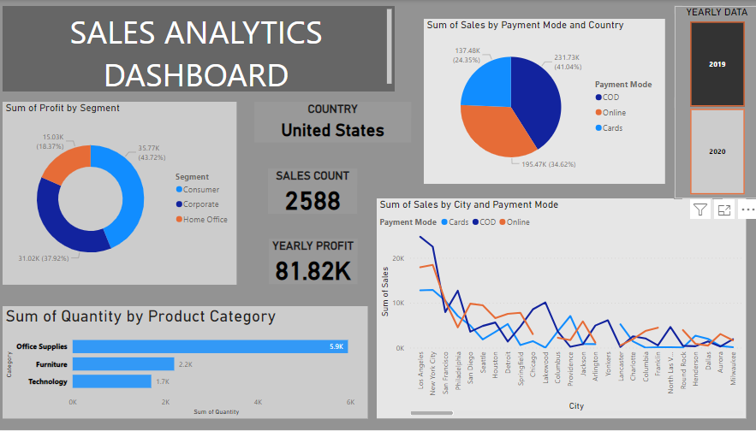
REPORT

Slide 5
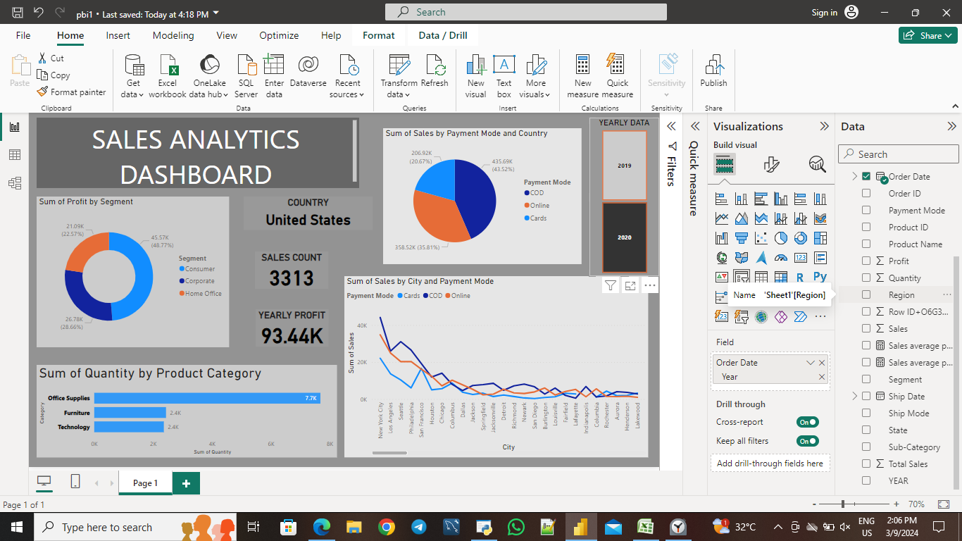
REPORT

Slide 6
DATA INSIGHTS
Data analysed of sales in country : United States
Yearly scaler
Cards –
Total sales count --2019 : 2588
2020 : 3313
Yearly profit -- 2019 : 81.82 k
2020 : 93.44 k
Pie chart - Different payment modes used
Line graph – Sum of sales city wise
Donut chart – Profit in each segment
Bar stack chart - Choice in product categories

Slide 7
CONCLUSION
So after visualizing the sales data, here is the conclusion
The company is having its sales in different region in U.S. with more in some and less in others, as per line chart need to focus on more outlets in cities with higher sales. Payment mode still hzave more COD so need to put COD for every product to strengthen bonds with customers. 48% sales are from consumer segment need to focus more on the same. Category wise office supplies are more in demand, can diversify in the same with more variety.
Overall the yearly sales and profit are increasing which shows good growth for the company,can still get better.
THANKYOU!

